Slide 1



Slide 2

Introduction
Founded in 1994 by Jeff Bezos, Amazon has evolved from an online bookstore to a diverse e-commerce giant.
Prime Membership offers exclusive deals and entertainment, fostering customer loyalty.
AWS revolutionizes cloud computing with scalable solutions.
Global expansion drives innovation through diverse investments and acquisitions.

Slide 3
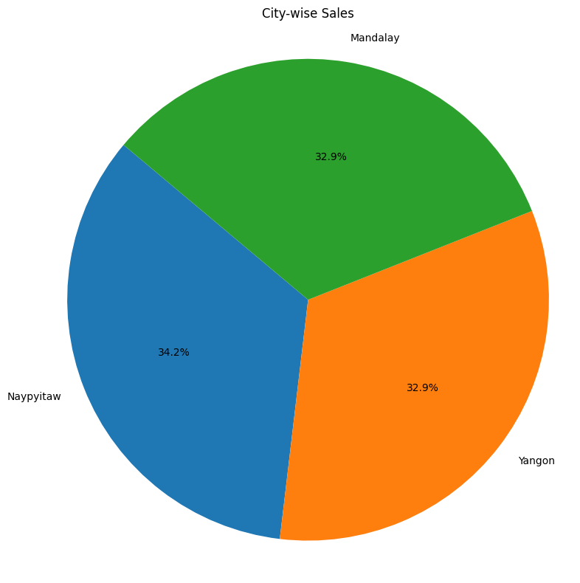
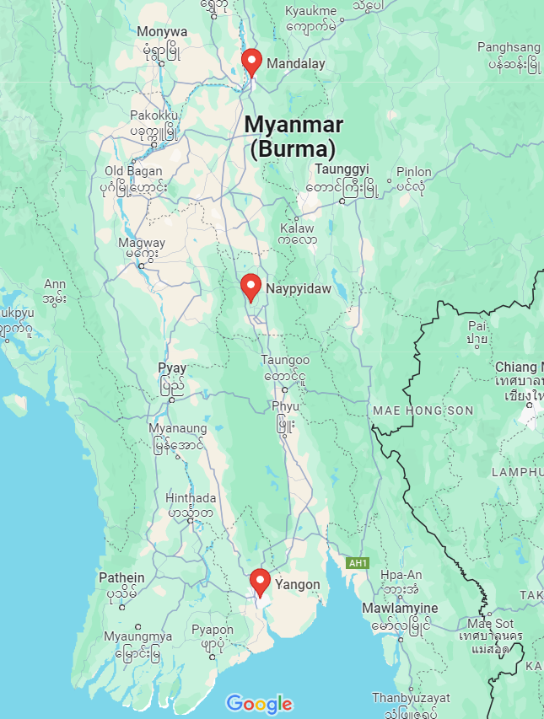
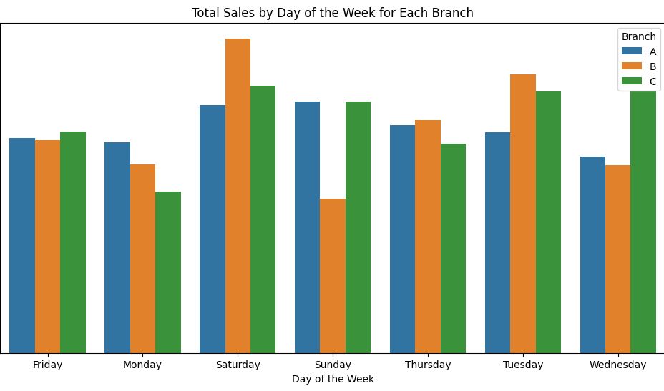
Location - Analysis

Slide 4

By Location analysis we can make changes based on below Pointers to Increase Sales:
Know who buys what and where.
Check out rivals for edge.
Guess future sales for planning.
Make data easier to understand.
Listen to customers to sell better.

Slide 5
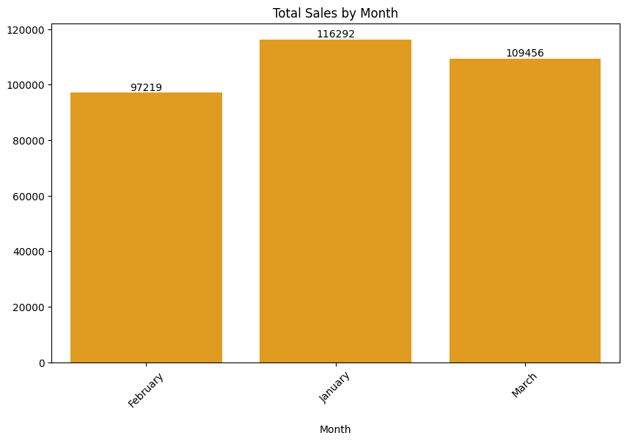
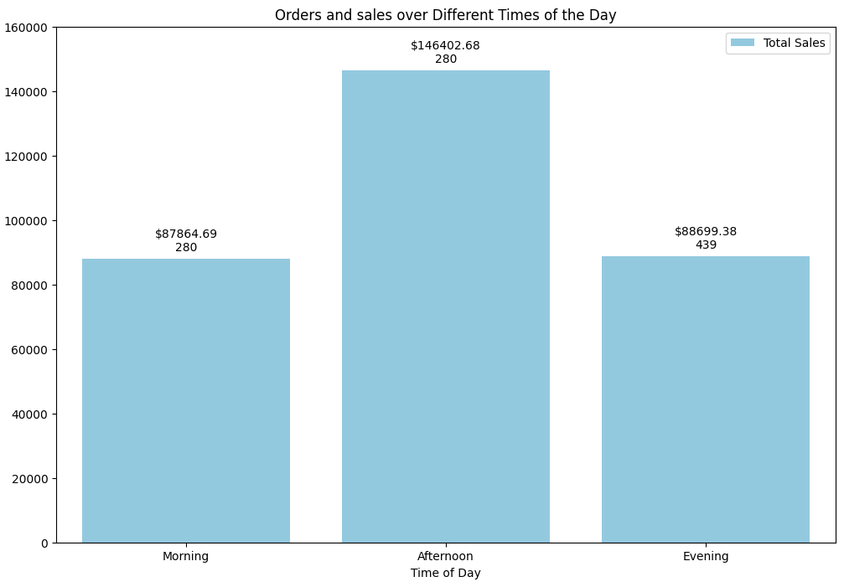
Sales Analysis

Slide 6

Sales Analysis
Strategic Sales Promotion: Leverage January's sales peak with targeted discounts to drive engagement and increase revenue.
Timely Offers for Maximum Impact: Introduce limited-time deals during afternoon hours, aligning with peak order times to spur immediate customer action.
Payment Diversity for Customer Convenience: Expand payment options to accommodate diverse preferences, ensuring seamless transactions and enhanced customer satisfaction.
Elevate Membership Benefits: Enhance membership value by offering expedited delivery and exclusive perks, fostering loyalty and boosting revenue from dedicated customers.

Slide 7
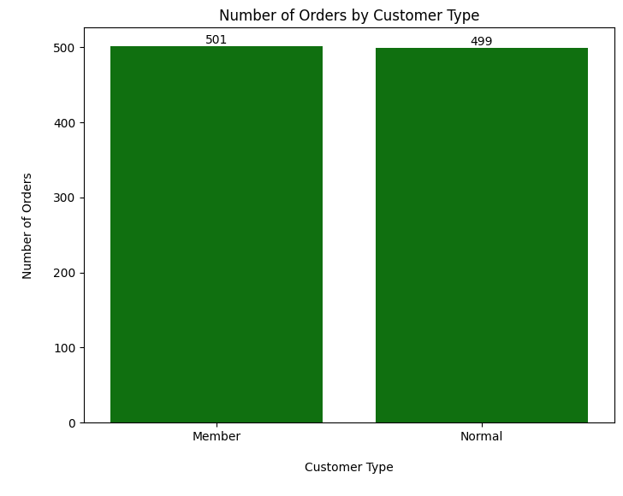
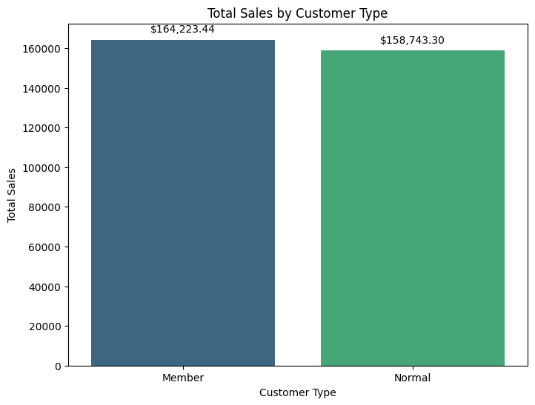
Customer-type analysis

Slide 8
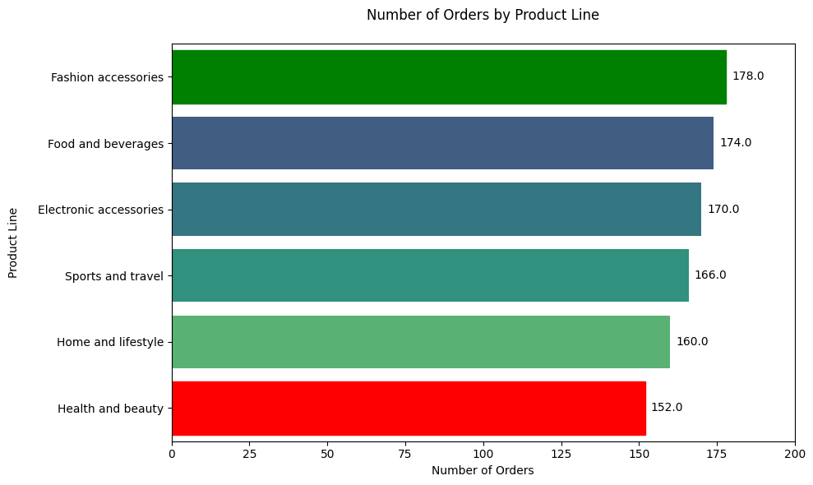
Product Analysis

Slide 9
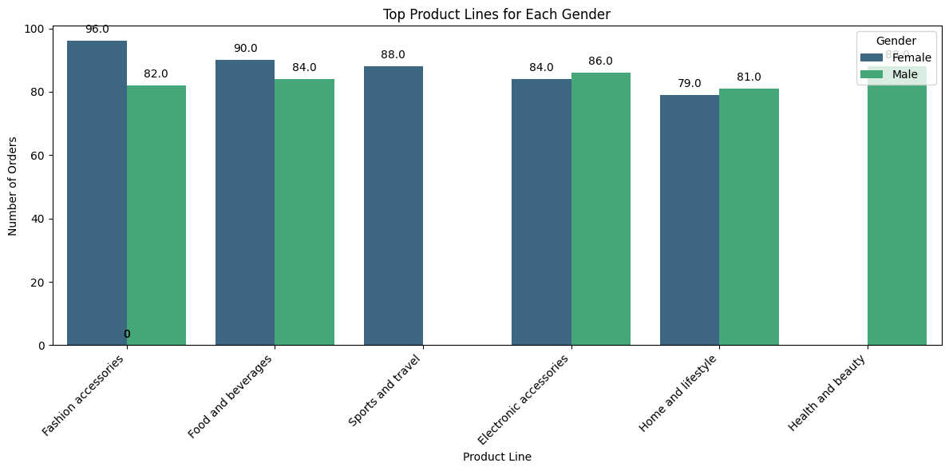
Gender Product Preferences

Slide 10

Product Insight
Female customers show a strong preference for fashion accessories, food and beverages, and sports and travel products.
Male customers demonstrate higher interest in health and beauty products, electronic accessories, and food and beverages.
There is potential to increase sales by targeting female customers with a wider range of the health and beauty products.
For male customers, focusing on electronic accessories and expanding offerings in fashion accessories could drive sales growth.
Understanding gender-specific preferences enables tailored marketing strategies and product diversification to maximize revenue.

Slide 11
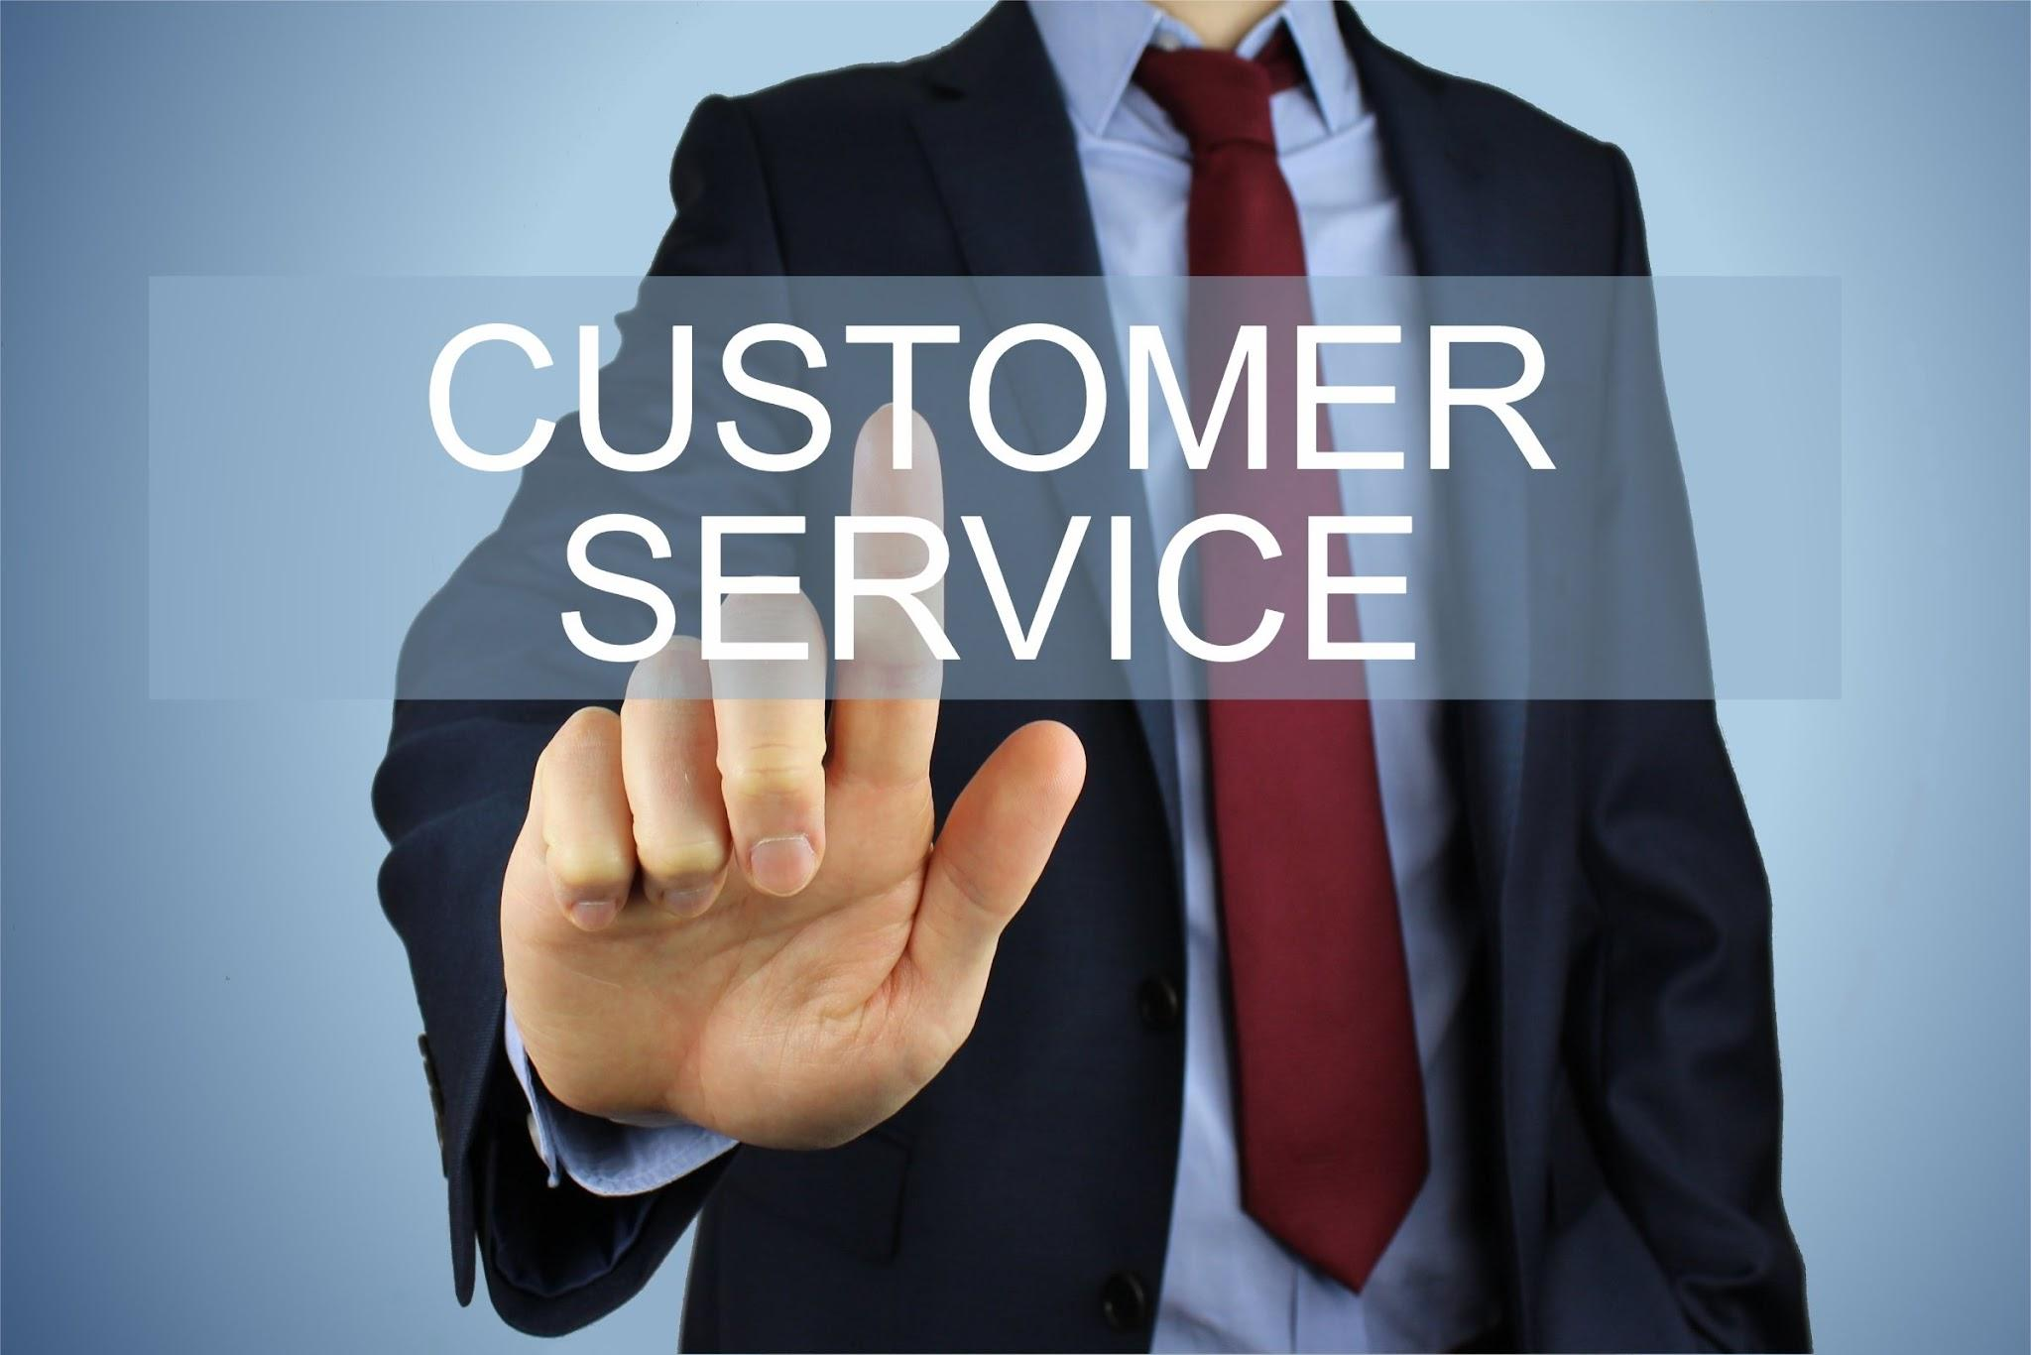
Customers Analysis
Enhance product quality to build trust and reputation.
Offer competitive pricing to attract budget-conscious customers.
Provide clear and appealing product descriptions and images.
Implement customer-friendly return policies to reduce purchase hesitancy.
Launch targeted marketing campaigns highlighting unique features or benefits.

Slide 12
Insights
Identify top-selling product lines and their revenue contribution.
Analyze sales trends by time of day, day of the week, and month.
Explore customer demographics to understand buying patterns.
Assess sales performance across branches and cities.
Evaluate new payment methods and their popularity among customers.

